Slide 1
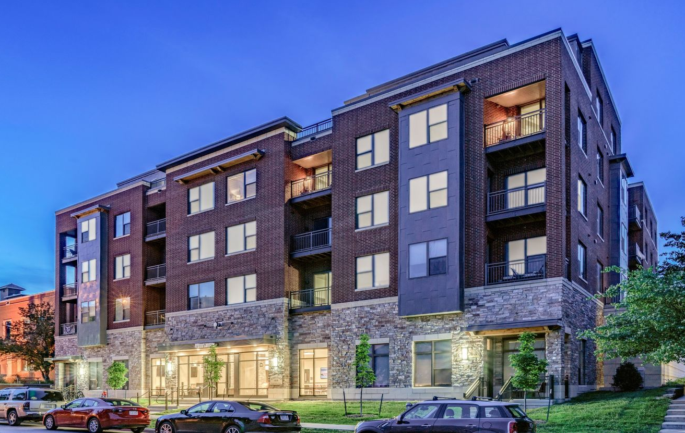

Factors affecting Rent in Iowa city
Calvin Marks, Scott Kerno, Will Zheng, Cayden Redd

Slide 2


Table of Contents
Executive Summary
Problem Statement
Data
Methodology
Conclusions

Slide 3





Executive Summary
Problem
Data Source
How do certain features such as the distance from campus, square footage, # of bathrooms, etc., contribute to the prices of apartments in the Iowa City/Coralville area?
Data was extracted from Zillow.com for apartments, and Google Maps for straight line distance.
Methods
Measures
Used web-scraping to gather data and transfer it to an excel sheet, running multiple linear regression, checking for multicollinearity, and finding the parsimonious model.
Is there a significant relationship between price and the following factors: bedrooms, bathrooms, square feet, parking, and distance from campus.
Conclusions
The significant variables; number of bedrooms, square footage, and distance from campus drive monthly rent prices for apartments in the Iowa City/Coralville area.

Slide 4
Problem Statement
University of Iowa students would prefer an apartment that is reasonably priced and properly located in relation to campus.
What factors influence the price of an apartment?
Does the distance from campus have a significant impact on monthly rent?
Analytical problem:
Is monthly rent significantly affected by distance from campus, parking availability, # of bedroom, #of bathroom, and square feet of the apartment?

Slide 5

Problem Statement
Distance from Campus
The information students need for housing may include, but are not limited to:
Parking
Monthly Rent
Number of Bathrooms
Square Footage
Number of Bedrooms

Slide 6

Data
Sources and Limitations
Dataset and Dummy Variables
Regression and Collinearity
Residual Plot

Slide 7


Data: Sources and Limitations
Data Sources
Limitations
Zillow.com for apartments from Iowa City and Coralville
Google Maps for distance from campus as the crow flies
Not all apartments included square feet
Crow fly distance cannot account for real traveling distance.
Other variables may affect monthly rent, such as amenities
95% confidence interval
http://zillow.mediaroom.com/logos
https://1000logos.net/google-maps-logo/

Slide 8
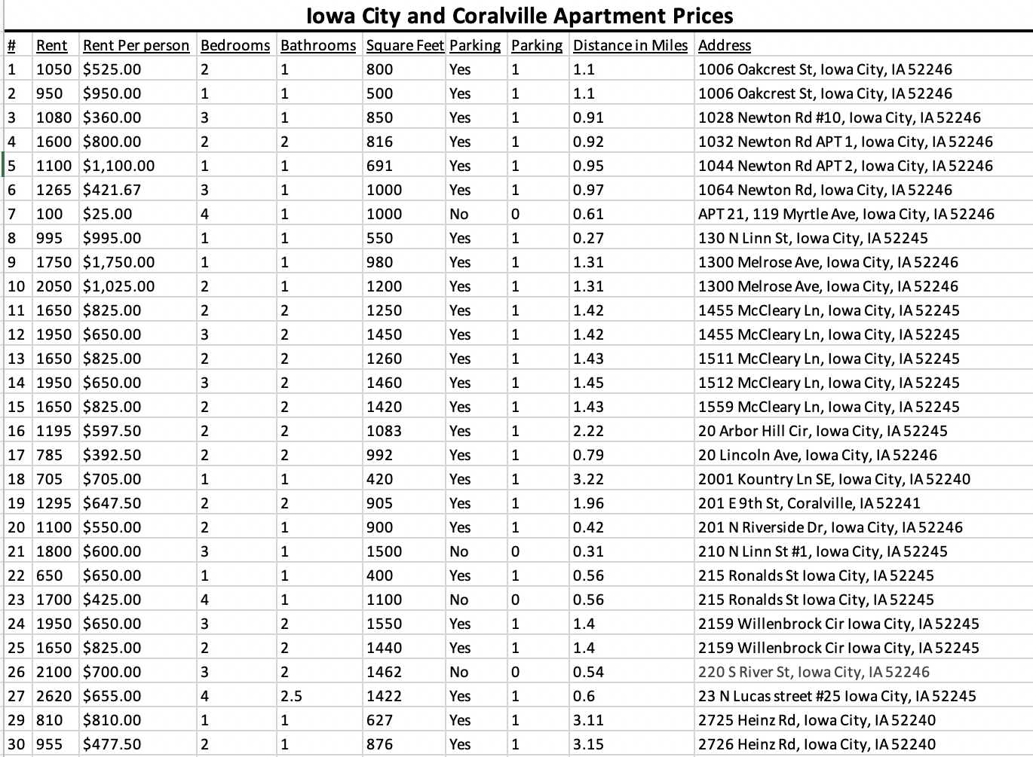
Data: Dataset Summary
Initial Dataset Preview
Dependent Variable:
Monthly Rent
Independent Variables:
Bedrooms
Bathrooms
Square Feet
Distance from Campus (in miles)
Dummy Variable:
Parking (yes or no)

Slide 9
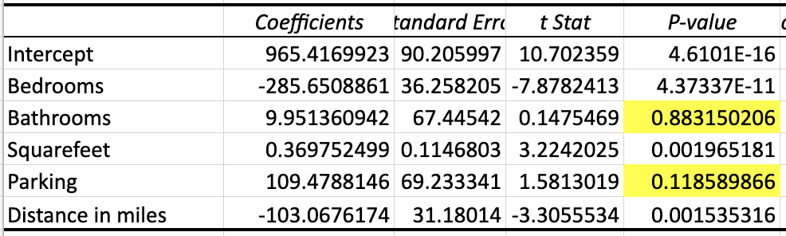
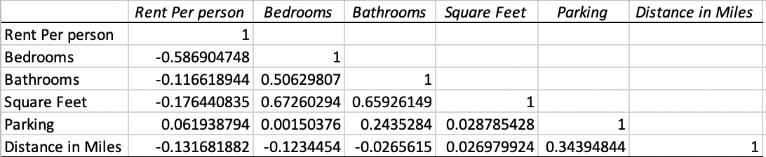

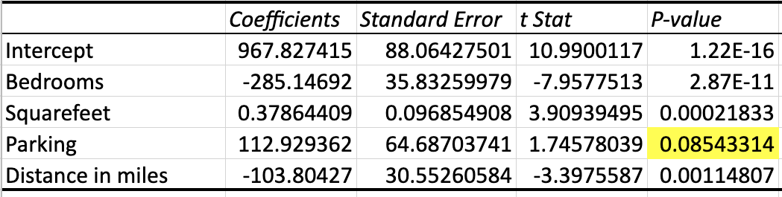
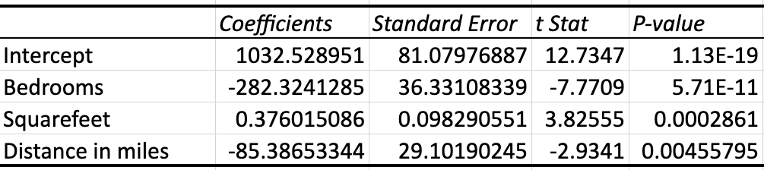
Data: Regression and Collinearity
Finding the Parsimonious Model (α=.05)
Collinearity
No correlation > .75, no severe sign of multicollinearity.
Variables Removed: Bathrooms and parking

Slide 10
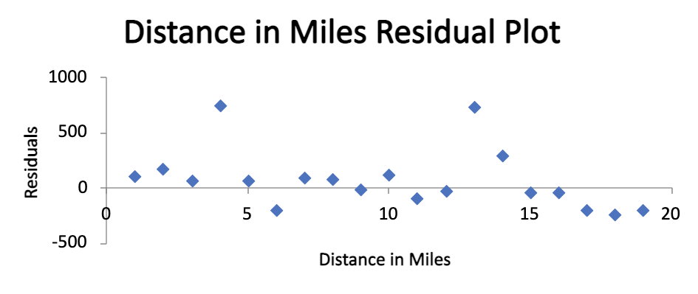
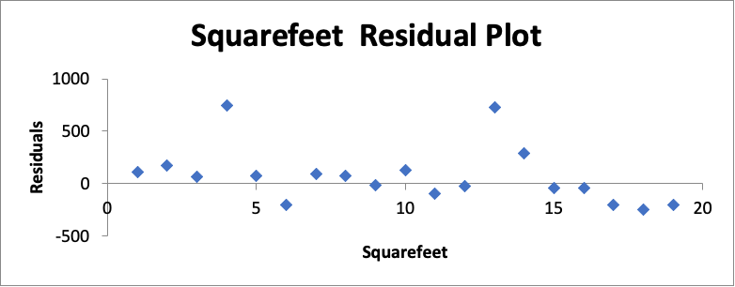
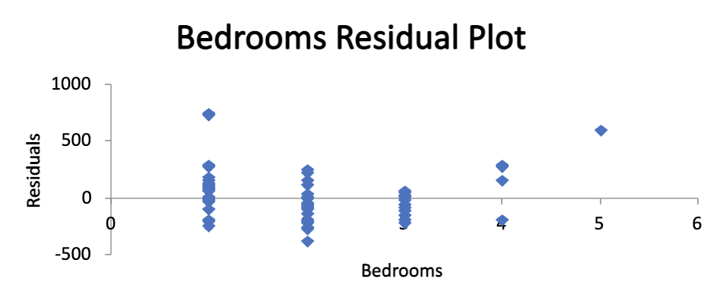
Data: Residual Plots

Slide 11

Methodology
What we are measuring
Hypothesis Testing
Dataset Conclusions

Slide 12
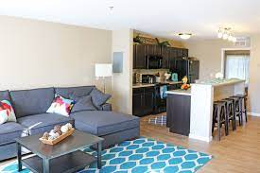
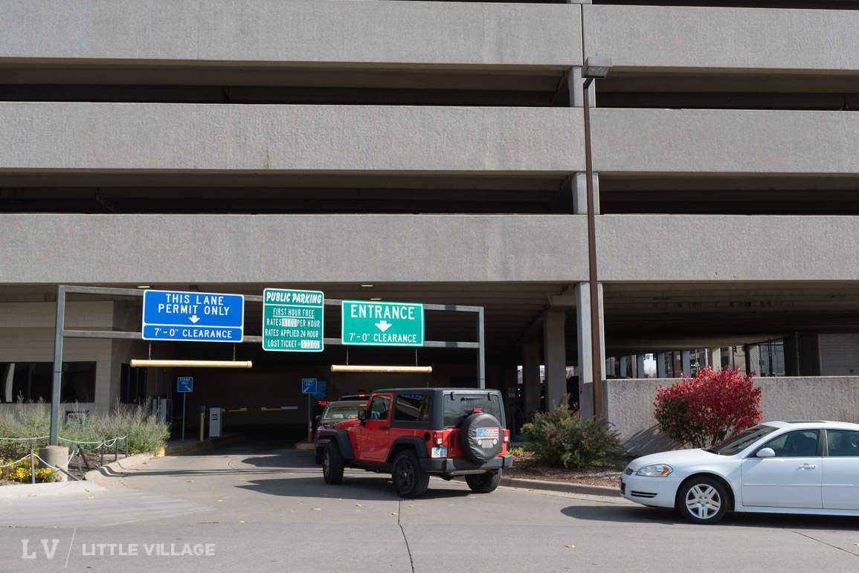
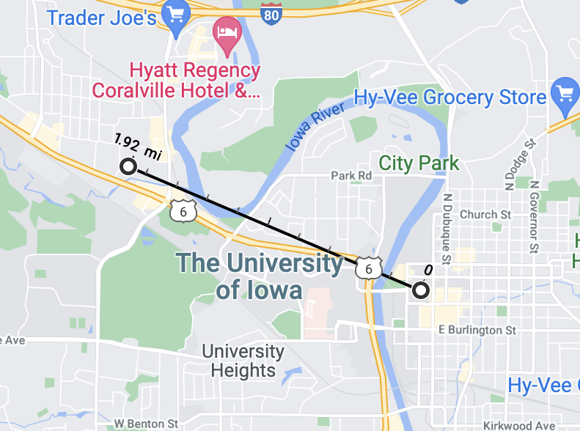
Methodology: What We are measuring
Information extracted using Google Chrome web scraping and Google Maps
Bedrooms: Does the number of bedrooms decrease the price of monthly rent?
Bathrooms: Does the number of bathrooms increase the price of monthly rent?
Square Feet: Are apartments more expensive the larger they get?
Parking: Are apartments with parking spaces available more expensive?
Distance from Campus: Do apartments have higher rent the closer they are to campus?
https://www.thequartersiowacity.com/apartments/
https://littlevillagemag.com/parking-fees-are-returning-to-downtown-iowa-city/

Slide 13
Methodology: Hypothesis Testing
H_{o} = The distance from campus and other variables have no significant impact on the monthly rent of apartments
H_{a} = The distance from campus and other variables have a significant impact on the monthly rent of apartments _{= nu}

Slide 14
Final Dataset Conclusions
y = 1032.53 - 282.32b + 0.38f - 85.39d
_{y = monthly rent}
_{b = number of bedrooms}
_{f = square footage}
_{d = distance from campus}
_{Variables removed:}
_{1. Bathrooms}
_{2. Parking}

Slide 15
Conclusion
Problem: What variables have a significant impact on monthly rent for apartments?
Hypothesis test conclusion: The number of bedrooms, square footage, and distance from campus have a significant impact on the monthly rent of apartments.
Parking and the number of bathrooms do not have a significant impact on monthly rent.
For each additional bedroom, monthly rent per person decreases by $282.32.
For each square foot in size the apartment is, monthly rent increases by $0.38.
For each additional mile the apartment is away from campus, monthly rent decreases by $85.39.
Our regression model can predict the monthly rent for apartments in Iowa City and Coralville.

